Slide 1



Architectures for PostgreSQL High Availability and Disaster Recovery (HA/DR)
postgrespro.com
postgrespro.ru
Alexey Shishkin
a.shishkin@postgrespro.com

Slide 2


Postgres Professional
◆ Postgres Professional, established in 2015, is a key
contributor to PostgreSQL community
◆ At Postgres Professional we develop Postgres Pro database,
a private PostgreSQL fork
◆ Postgres Professional also specializes in 24x7 technical
support and other professional services (database
migration, audit and performance tuning) for PostgreSQL
2

Slide 3
HA/DR for PostgreSQL databases
◆ When do you need to consider an HA/DR architecture ?
◆ HA/DR for Postgres in a nutshell (how to make it work) ◆ Introduction to commonly used HA/DR architectures
◆ Pros and cons of various HA/DR architectures for
PostgreSQL
◆ HA/DR field experience
3

Slide 4
SLA: RTO and RPO
RTO (Recovery Time Objective) - how long an
application can be unavailable for business users
- 99,99% - 52,56 minutes of downtime per year (~0,9 hrs.)
- 99,9% - 525,6 minutes of downtime per year (~9 hrs.)
- 99% - 5256 minutes of downtime per year (~90 hrs.)
RPO (Recovery Point Objective) - how much business
data can be lost
4

Slide 5
A sample customer’s SLA
◆ Mission critical application - RTO - 99,99%, RPO - 0
◆ Business critical application - RTO - 99,9%, RPO - 0
◆ Business operational application - RTO - 98%, RPO - 1 hr.
◆ Office operational application - RTO - 90%, RPO - 12 hrs.
5

Slide 6
HA/DR technologies (1/4)
◆ Manual switchover/failover
- the fewer moving parts in the technology stack the better
- monitoring and alerting systems work fine to inform the Operations team about the database issues
- switchover/failover scenarios are well documented and both day and night shifts of the Operations team have adequate expertise to cope with database availability issues
- RTO is not very strict (up to 5 minutes for switchover/failover tasks)
- the number of databases is relatively small (up to 50)
6

Slide 7
HA/DR technologies (2/4)
◆ HA-cluster (don’t confuse this with Postgres database
cluster, which is a collection of databases that is managed
by a single instance of a running database server)
- RTO is strict (within a minute for switchover/failover tasks)
- the number of databases is big (up to 100+)
7

Slide 8
HA/DR technologies (3/4)
◆ Replication
- logical (database transaction)
- streaming (database block)
- file system (block device)
- disk/LUN (raw device)
◆ Each kind of replication can be synchronous or
asynchronous
8

Slide 9
HA/DR technologies (4/4)
Backup
- online or offline
- full or incremental
- physical or logical
- data files or WAL files
- via database tools or via disk-array snapshots
9

Slide 10
HA-cluster
The list of HA-clusters (sorted by popularity among our
customers)
- Patroni - https://github.com/zalando/patroni
- Corosync/Pacemaker - https://github.com/ClusterLabs
- Stolon - https://github.com/sorintlab/stolon
- Postgres Pro Multimaster -
https://github.com/postgrespro/mmts
- Veritas - https://www.veritas.com/availability/infosc ale ₁₀

Slide 11
Patroni and Stolon (1/2)
◆ Patroni and Stolon are similar in functionality and architecture
- depend on DCS (Distributed Configuration Store)
- require Postgres streaming replication
- suitable for physical servers and virtual machines (VMs)
- open-source and free of charge
◆ Patroni uses external TCP-proxy to connect to master or
standby(s)
◆ Stolon has built-in TCP-proxy to connect to master or standby(s)
11

Slide 12


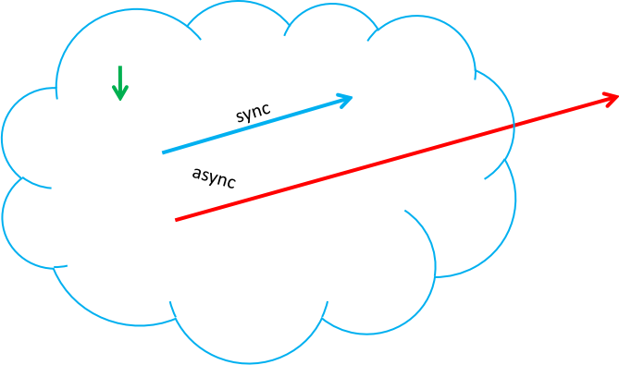



Patroni and Stolon (2/2)
Client
DCS
Manager
Entry point
Consensus
DCS
DCS
Standby
Master
Standby
Manager
Entry point – TCP-proxy, Virtual IP DCS - etcd, Consul, ZooKeeper
Manager - patroni-bot, stolon-sentinel Consensus - Raft-protocol
Manager
12

Slide 13



Patroni architecture
Master
Standby
Standby
Patroni
< >
Patroni
< >
Patroni
api
api
api
13

Slide 14







Patroni (3-node HA-cluster)
Client
Client
TCP-proxy
TCP-proxy
etd
etd
Master
Standby
Failover
Master
sync
Standby
Standby
Master
14

Slide 15


Patroni (2+1 HA-cluster)
Client
Client
TCP-proxy
TCP-proxy
etd
Failover
etd
Master
Master
Standby
async/sync
Master
15

Slide 16
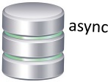


Stolon architecture
Client
Proxy
Proxy
Proxy
sync
Standby
Master
Standby
Keeper
Keeper
Keeper
Sentinel
Sentinel
Sentinel
api
16

Slide 17
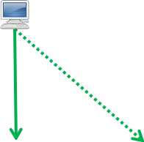

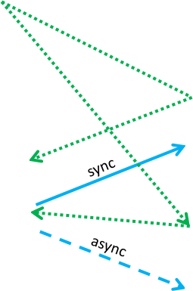
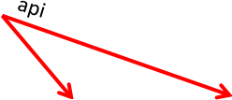

Stolon (3-node HA-cluster)
Client
Client
sync
Proxy
Failover
Proxy |  | Proxy
Proxy
Master
Standby
Standby
Master
Proxy
Master
Standby
17

Slide 18
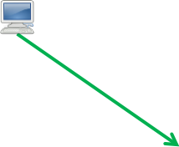
Stolon (2+1 HA-cluster)
Client
Client
api
api
Failover
Proxy
Proxy
Proxy
Master
Standby
Master
Master
async/sync
18

Slide 19
Corosync/Pacemaker and Veritas
◆ Corosync/Pacemaker and Veritas are similar in functionality and architecture
- use resource agents (disk volume, file system, IP-address, Postgres)
- use Virtual IP-address (VIP) to connect to master or standby(s)
- can be used with streaming replication and shared disk configuration
- mostly used with physical servers
- can be applied to build geo-clusters
◆ Corosync/Pacemaker is open-source and free of charge
◆ Veritas is proprietary and requires license (the only HA-cluster which
integrates with disk replication)
19

Slide 20


Corosync/Pacemaker and Veritas architecture
! Client
! Client
Virtual IP
Referee
Standby
Master
V
Virtual IP
quorum
quorum
Standby
Standby
Master
< >
>
sync
20

Slide 21


! Client
Corosync/Pacemaker (3-node HA-cluster)
Client
Virtual IP
Master
Virtual IP
Failover
Standby
Master
Master
quorum
sync
quorum
Standby
Master
Standby
21

Slide 22


Corosync/Pacemaker (2+1 HA-cluster)
! ^{Client} Client !
Referee
Failover
Virtual IP
Virtual IP
quorum
quorum
Referee
Master
Master
Standby
sync
Master
22

Slide 23
Postgres Pro Multimaster
◆ Postgres Pro Multimaster differs from other HA-clusters
- uses logical replication
- all nodes can process read-write requests (all nodes are masters)
- delivers minimal possible switchover/failover time (single digit seconds)
- open-source, but requires license to run in a production environment
23

Slide 24
Postgres Pro Multimaster architecture
3-phase commit:
1. PREPARE
2. PRECOMMIT
3. COMMIT
Master
Master
Logical replication
Master
24

Slide 25

Postgres Pro Multimaster (3-node HA-cluster)
Client
Client
Master
Master
Failover
Master
Master
Multimaster
Master
Master
25

Slide 26
Postgres Pro Multimaster (2+1 HA-cluster)
Client
Client
Referee
Failover
Referee
Master
Master
Multimaster
Master
Master
26

Slide 27
Streaming replication
◆ Replication is used for disaster recovery purposes (main site lost)
◆ If the required RPO is strictly zero, synchronous replication has to be
used between main and DR sites, otherwise asynchronous replication is
enough
◆ Postgres streaming replication is the most popular solution among the
customers, it’s included both in PostgreSQL and Postgres Pro database
◆ Streaming replication is integrated with HA-clusters (Patroni,
Corosync/Pacemaker, Stolon) and uses master/standby(s) configuration, where master is available for read/write requests, while standby(s) can only be used for read-only requests
27

Slide 28
Logical replication
◆ Postgres logical replication is slower than streaming replication by
design
◆ Logical replication is more flexible
- replication of only some database objects instead of whole database
- replication between two databases of different major versions
- bi-directional replication between two databases
◆ Postgres Pro Multimaster uses logical replication to set up an HA-cluster where all nodes can handle read/write requests
28

Slide 29
Disk/LUN replication
◆ Replication is on the disk-array level (usually requires a license)
◆ Disk-arrays have to support this replication on both main and DR sites
(have to be of the same type)
◆ Delivers maximum performance for write intensive load profiles
◆ Veritas HA-cluster is integrated with disk/LUN replication
29

Slide 30
Backup (1/2)
◆ The most popular tool for database backup among our customers is ‘pg_probackup’ - https://github.com/postgrespro/pg_probackup
- supports both full and incremental backup/restore
- supports point-in-time-recovery (PITR)
- provides backup catalog
- supports backup compression
- backup validation without actual data restore
- parallelism of backup/restore tasks
- and many more
30

Slide 31
Backup (2/2)
◆ The other popular way for backup/restore employs disk-array snapshots, which allows to do backup/restore of the database very fast (seconds to single digit minutes) regardless of its size
◆ Built-in PostgreSQL - ‘pg_basebackup’
- full backups only (no incremental backups)
- no parallelism of backup/restore tasks
◆ Built-in PostgreSQL - ‘pg_dump’ and ‘pg_dumpall’
- logical backup (no PITR)
31

Slide 32

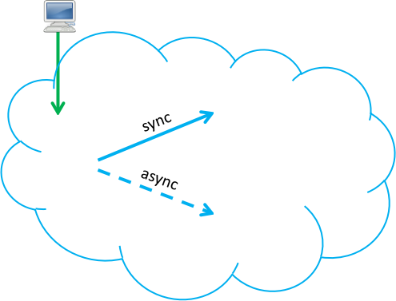


Typical HA/DR architectures use HA-clusters, replication and backup: - local HA-cluster (all nodes within one site)
- stretched HA-cluster (between two or three sites, up to 30 km to each other)
Client 3-node HA-cluster _{Client} 2+1 HA-cluster
Referee
sync
Standby
32
Standby
Master
Standby
Master

Slide 33
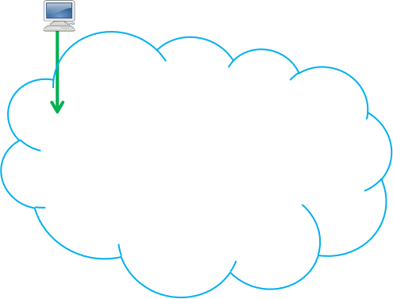

Geo HA-cluster (50+ km between regions) (1/2)
Client
Main region Standby | Internet
as Standby | ync | as | ync
DR-region
Standby
Master
33

Slide 34

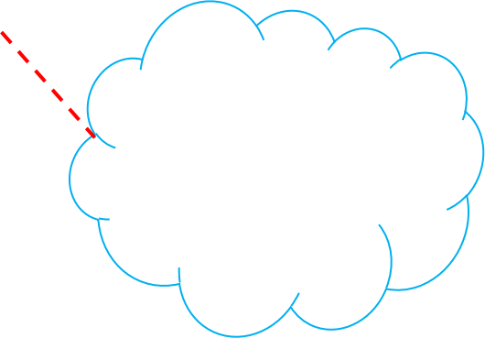


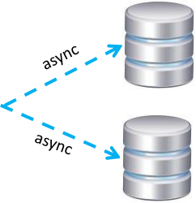
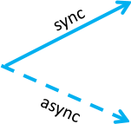
Geo HA-cluster (50+ km between regions) (2/2)
Client
dnsupdate
DNS
Referee
Internet
Leaf
standby
Standby
Master
Cascade
Standby
Standby
async async
Leaf
standby
Main region
DR-region
34

Slide 35
Postgres Pro enhancements (1/2)
◆ Support for relaxed synchronous replication restrictions, which allows
the master server to continue running while some of the standbys are temporarily unavailable:
https://postgrespro.com/docs/enterprise/13/runtime-config- replication#GUC-SYNCHRONOUS-STANDBY-GAP
◆ Automatic database block repair via streaming replication from standby
in case of data corruption:
https://postgrespro.com/docs/enterprise/13/warm-standby#REPAIR-PAGE- FROM-STANDBY
35

Slide 36
Postgres Pro enhancements (2/2)
◆ Corrupted WAL data restore from in-memory WAL buffers:
https://postgrespro.com/docs/enterprise/13/wal-restoration
◆ Support for database minor version upgrades without a database
instance restart:
https://postgrespro.com/docs/enterprise/13/release-proee-13-2-1
◆ Compressed file system (CFS) offers database compression at the
database block level:
https://postgrespro.com/docs/enterprise/13/cfs
36

Slide 37
Documentation links
◆ PostgreSQL ‘High Availability, Load Balancing, and Replication’
documentation:
https://www.postgresql.org/docs/14/high-availability.html
◆ PostgreSQL ‘Backup and Restore’ documentation:
https://www.postgresql.org/docs/14/backup.html
◆ Postgres Pro Enterprise documentation:
https://postgrespro.com/docs/enterprise/13/index
37

Slide 38




Architectures for PostgreSQL High Availability and Disaster Recovery (HA/DR)
Q & A
postgrespro.com
38

Slide 39
Postgres Professional
https://postgrespro.com/
info@postgrespro.com
postgrespro.com
39

